Slide 1
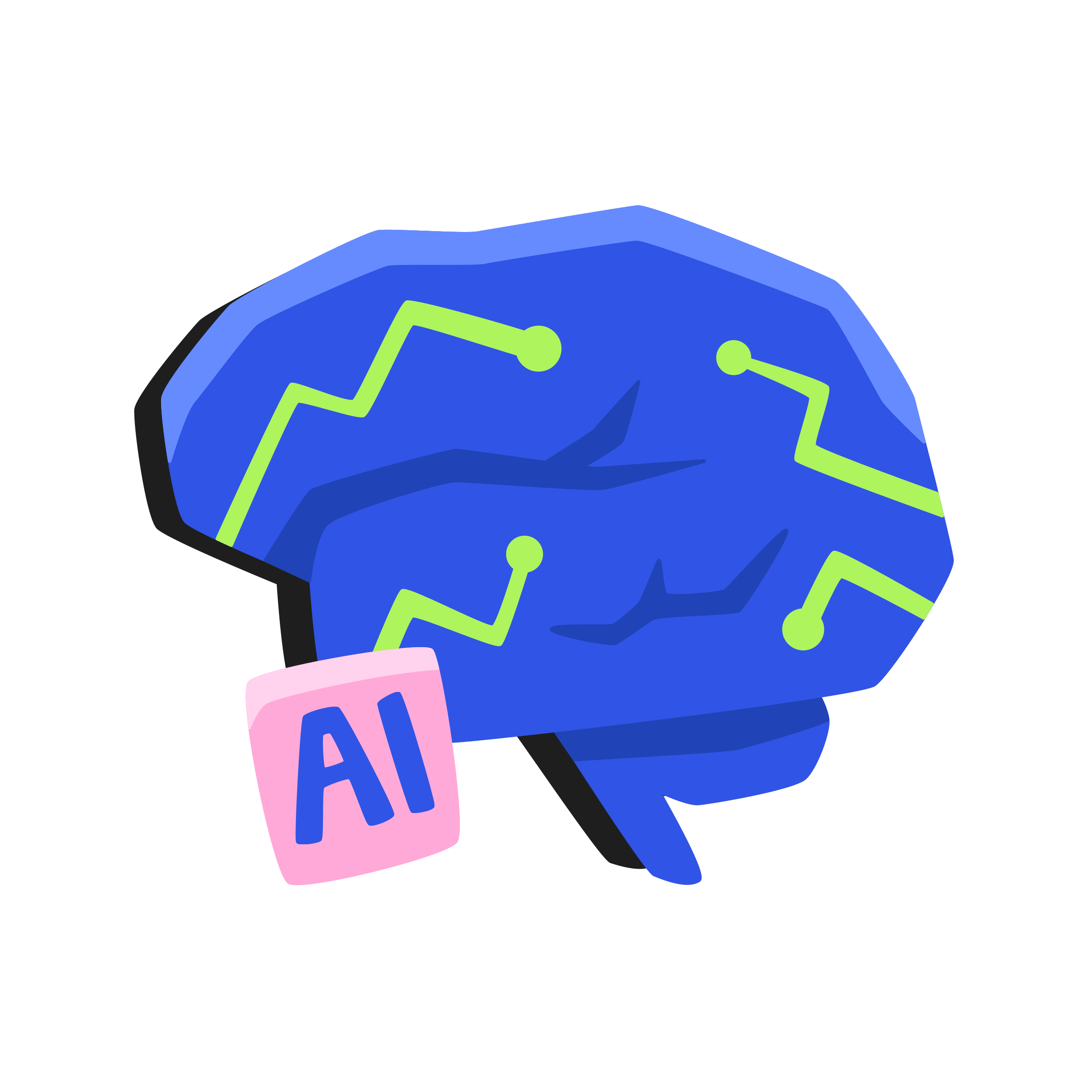
Natural Language Processing: Introduction to Hugging Face
Mina Farmanbar
Associate Professor, University of Stavanger
for engineers

Slide 2

Hugging Face Hub
Centralized platform for models and datasets.
Over 350k models, 75k datasets, and 150k demo apps (Spaces), all open source and publicly available.
Hosts models in Git repositories for version control.
Simplifies model selection and integration.
https://huggingface.co/docs/hub/en/index

Slide 3
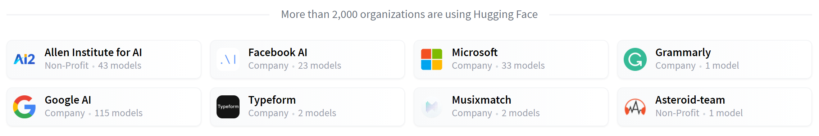
Transformers
Transformer models solve NLP tasks.
Transformers library creates and uses shared models.
Hugging Face Model Hub hosts and shares pre-trained models.
https://huggingface.co/datasets/huggingface-course/documentation-images/resolve/main/en/chapter1/companies.PNG

Slide 4
Transformers
The most basic object in the Transformers library is the pipeline() function.
It is the most high-level API of the Transformers library.
It connects a model with its necessary preprocessing and postprocessing steps, allowing us to directly input any text and get an intelligible answer:
Pre-processing
Model
Post-processing

Slide 5
Transformers
Some of the currently available pipelines are:
feature-extraction (get the vector representation of a text)
fill-mask
ner (named entity recognition)
question-answering
sentiment-analysis
summarization
text-generation
translation
zero-shot-classification

Slide 6


Transformers
Sentiment Analysis:

Slide 7
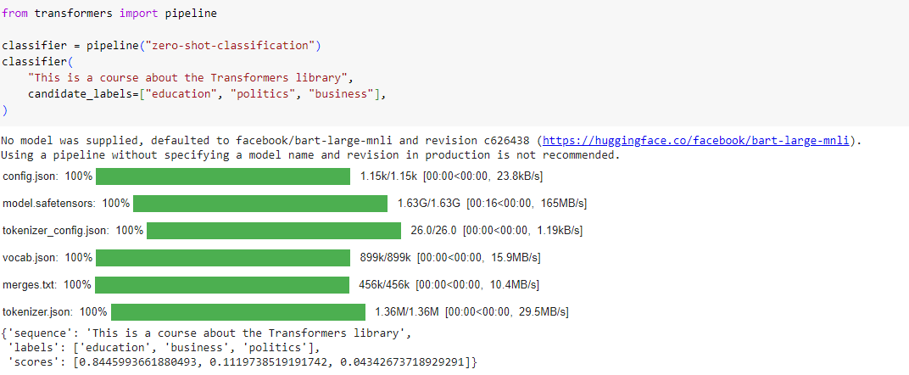
Zero-shot classification

Slide 8
Using any model from the Hub in a pipeline
You can also choose a particular model from the Hub to use in a pipeline for a specific task.
Go to https://huggingface.co/models
Click on the corresponding tag on the left to display only the supported models for that task

Slide 9
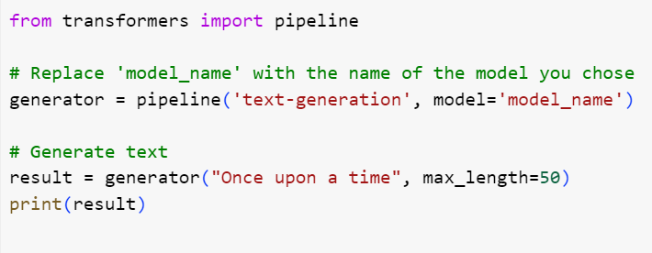
transformers

Slide 10
Thank you!
Mina Farmanbar
mina.farmanbar@uis.no

